Slide 1

Data Science- From Data to Patterns
Professor Mais Alraee

Slide 2
Data- What is it and Why it matters?
Data is information or facts about something. It can be numbers, words, pictures, voices, even emotions!
Think of data as information that helps us discover patterns and answer questions.
Example: If we collect information about how students get to school (bus, car, walking, biking), we can see which way is the most common.
Data helps us turn information into insights about the world around us.

Slide 3
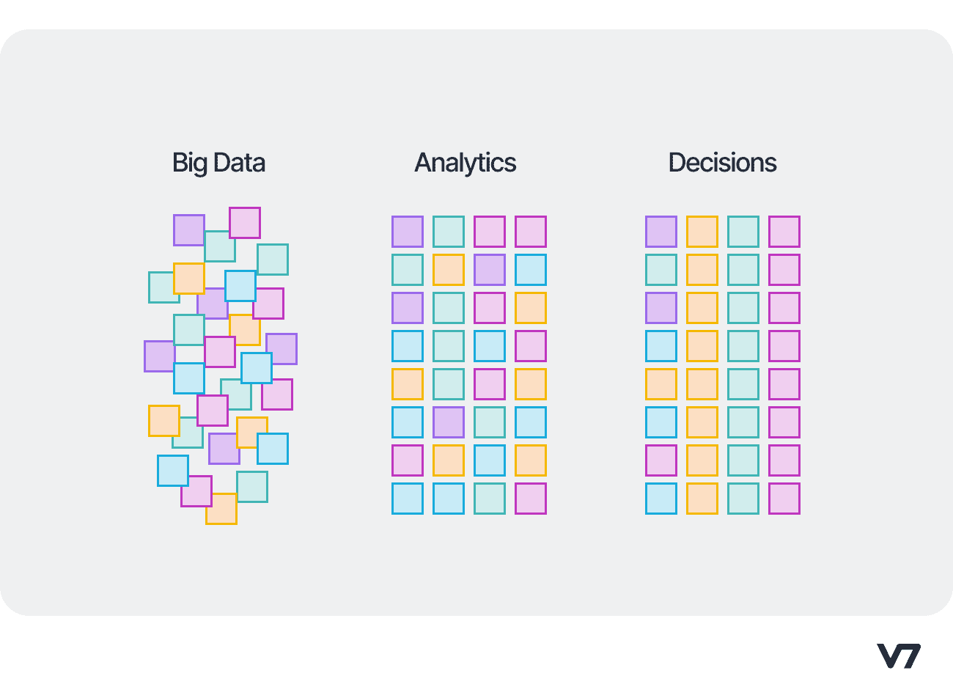
Data Scientists
1- Collect information (called "data") about different things.
2- Use models and visualization to find patterns or hidden insights in the data.
3- Use the information that they got to make better decisions!

Slide 4
Be a Data Scientist for the next 30 min!
Step 1: Collect information
In your group of 4, collect the following information:
How many hours per week does each person exercise?
How many hours per week does each person spend on social media?
How many hours of sleep does each person usually get per night?
What is each person’s favorite subject? (record this on the side of the table)
Math, English, Social Studies, Science, or Art
Record the information in your table.
Do NOT write anyone’s name.
Don’t forget to collect your info!!

Slide 5
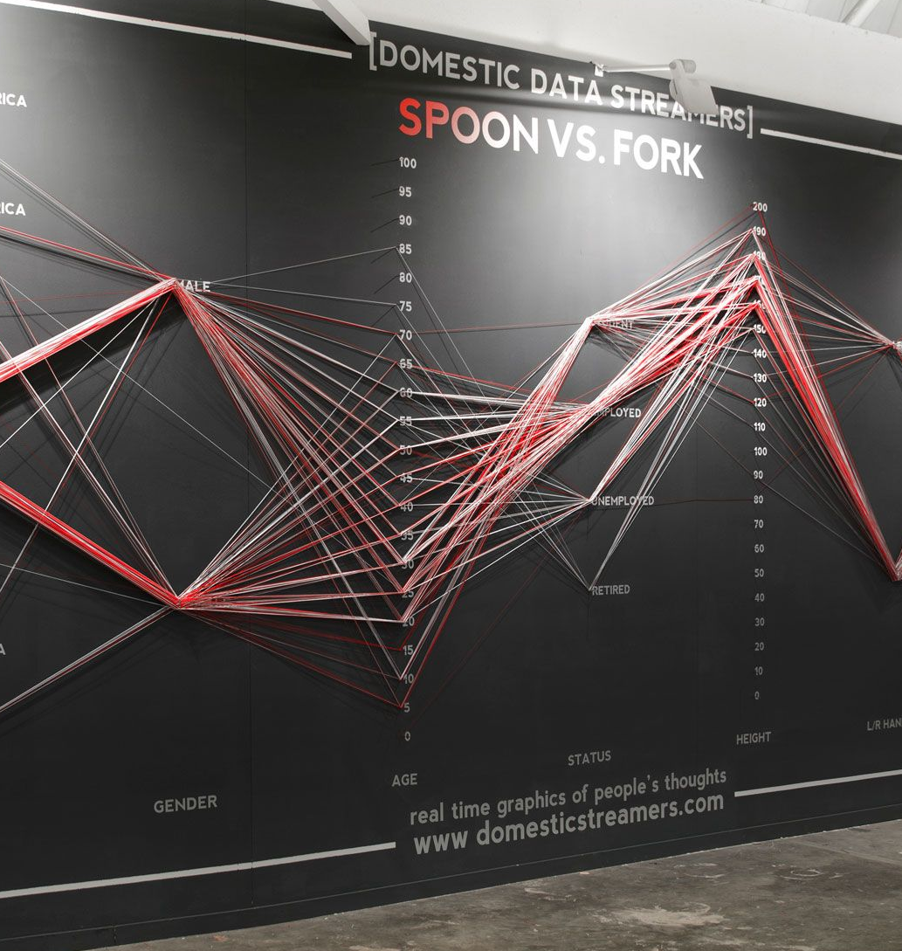
Be a Data Scientist for the next 30 min!
Step 2: Visualize Your Data
Your group will visualize your data using the strings and the board.
Each string color represents a favorite subject:
Lavender = Math
Teal = English
Yellow = Science
Blue = Social Studies
Maroon = Art
Use the correct color string for each person in your group.
Source: https://www.domesticstreamers.com/work/data-strings/

Slide 6
Be a Data Scientist for the next 30 min!
Step 3: Interpret the Visualization
Look at the strings on the board and discuss with your group. Can you answer these questions:
Which exercise category has the most students?
Which social media category has the most students? How about sleep?
Do students who sleep more also exercise more?
Do students who spend more time on social media sleep less?
Which favorite subject appears the most?
What are some other questions we could ask looking at this visualization?

